Slide 1
Applied Studies - Digital Technologies
Year 8

Slide 2
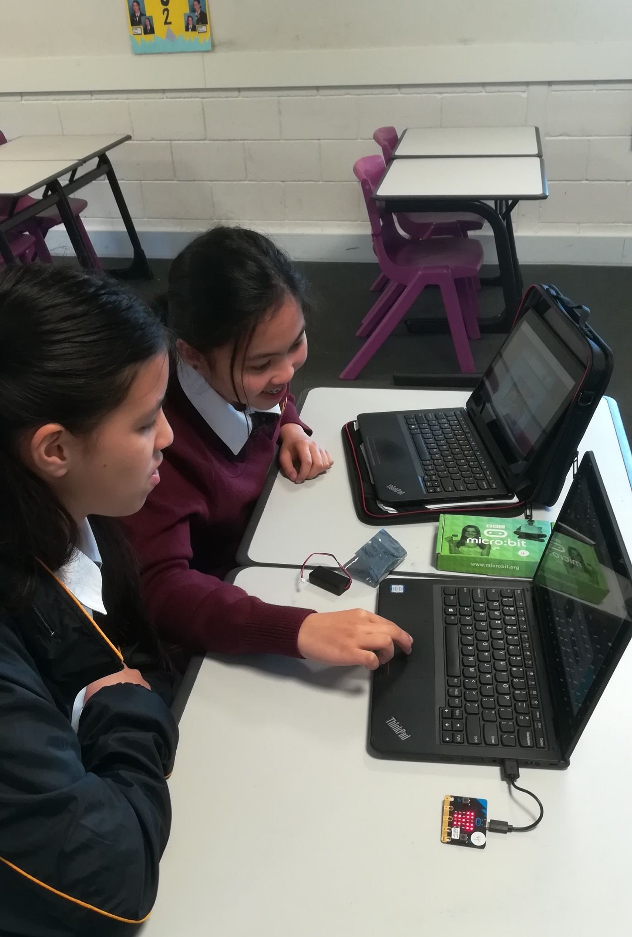
Digital Technologies
1 year course
Mix of theory and practical
Learn to code
Focus on cyber safety
Investigate how computers work
Develops problem solving skills
Individual projects and group work
Real world projects

Slide 3
Find out more…
Please feel free to contact Mrs Selina Kinne, Head of Technology and Applied Studies, at skinne@dominic.tas.edu.au

